Slide 1
Toronto Neighborhoods - Safe or not?(as of June 11, 2020)
By Aditya Kolluru

Slide 2
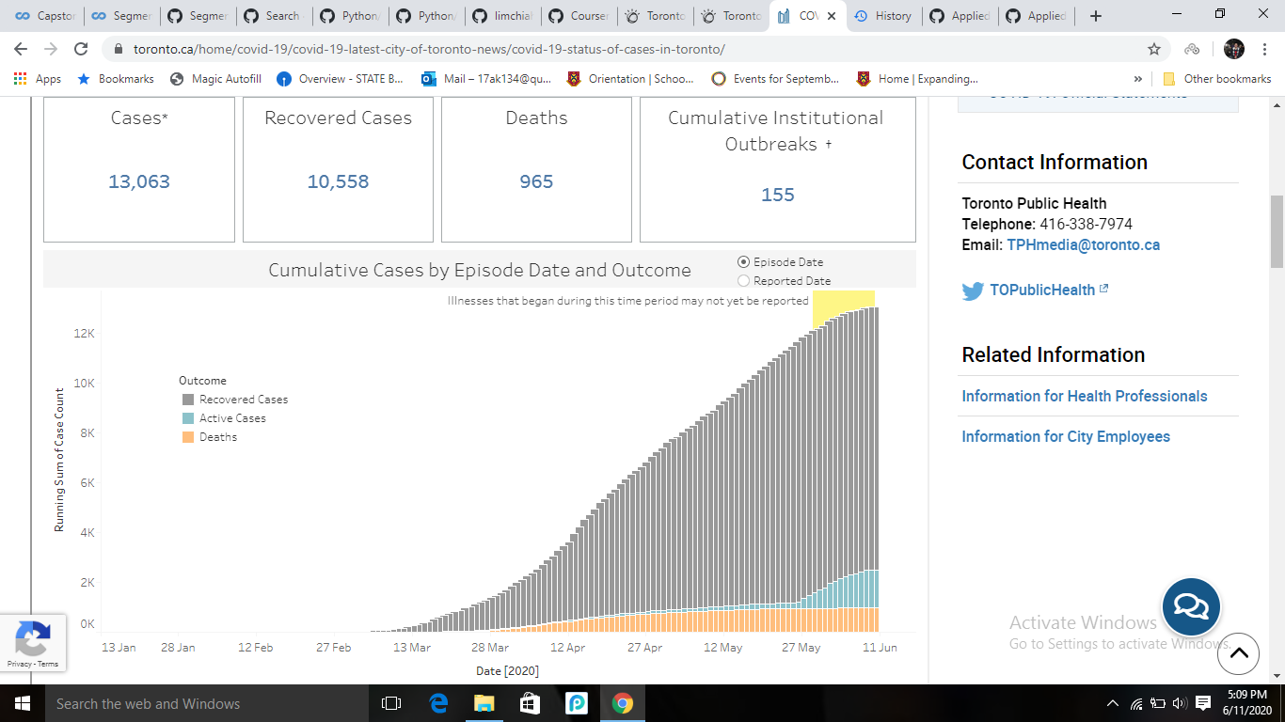
Toronto Covid-19 cases upto June 11, 2020:

Slide 3
Introduction:
The COVID-19 pandemic in Canada is part of the ongoing worldwide pandemic of coronavirus disease 2019 (COVID-19) caused by severe acute respiratory syndrome coronavirus 2 (SARS-CoV-2). Canada declared States of emergency in all its provinces. Due to this the bars, restaurants, cinemas, playgrounds, parks and other businesses and places where there are large social gatherings have been ordered closed by provinces, territories, and municipalities across the country. Initially, some jurisdictions allowed restaurants or bars to stay open with reduced capacity and social distancing.

Slide 4
Business Problem:
With easing social restrictions of the bars, restaurants, playgrounds and other places, people are worried how safe it is to go outside. Using data science methodology and machine learning techniques like clustering, this project answers the question,
1.Which neighborhood would pose the least risk if someone wants to go out to a restaurant or a sports field to play in Toronto?, although it is always recommended to stay home.

Slide 5
Data:
To solve the problem, we will need the following data
Covid-19 cases from all the neighborhoods in Toronto obtained from Toronto Covid-19 data.
List of all neighborhoods and postal codes in Toronto extracted from Toronto Postal Codes Wikipedia page by web-scraping techniques.
Latitude and Longitude coordinates obtained by using the Python Geocoder package.
Venue data for those neighborhoods by using Foursquare API.

Slide 6
Methodology:
The goal of this project is to provide correct information to people on which neighborhoods are safe to explore and which are to be avoided, given the venue.
Analytic Approach:
The city of Toronto has registered cases in 102 neighborhoods. To make the cluster analysis possible:
Initially, extract the Covid-19 case data from the Toronto Covid-19 data website and read it as an excel spreadsheet and convert it into a DataFrame. IBM watson has an in-built setting to build the data frame.
To get the postal codes of those neighborhoods, Python’s BeautifulSoup technique is used for web-scraping from Toronto Postal Codes, and the resultant data frame is joined with the original data frame to get the neighborhood names, cases and postal codes into one data frame.

Slide 7
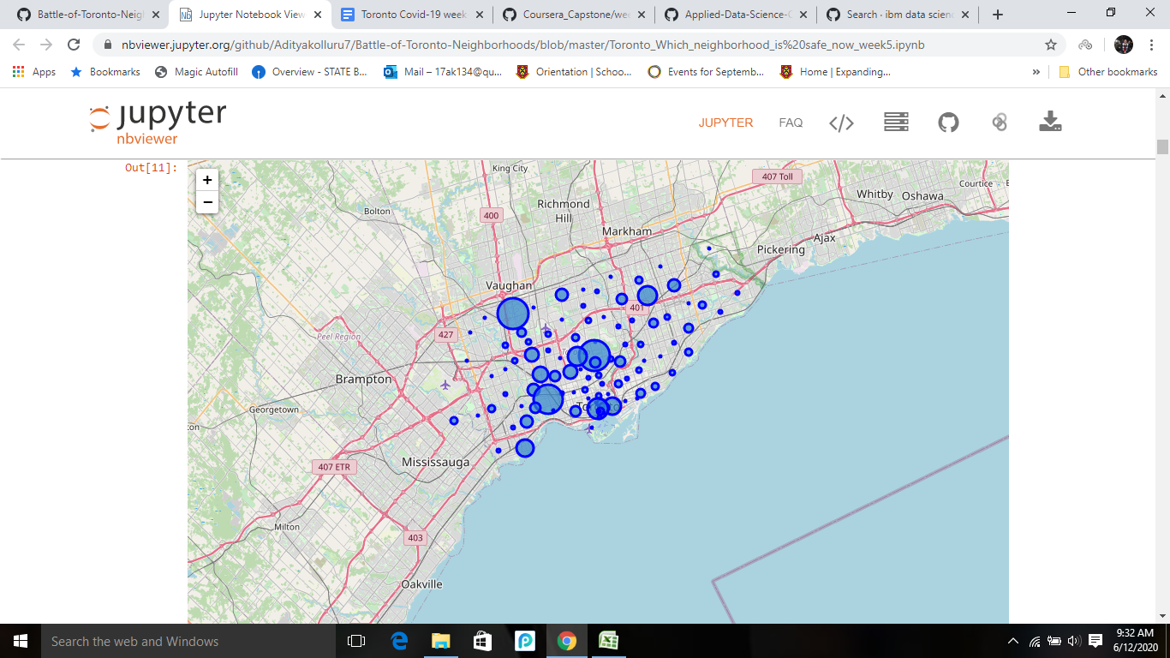
3.Foursquare API uses latitude and longitude to give the desired output. Python’s geocoder package is used to get the data and now it is populated into a new data frame and this is used to visualize a map in folium using size of markers as the number of cases.

Slide 8
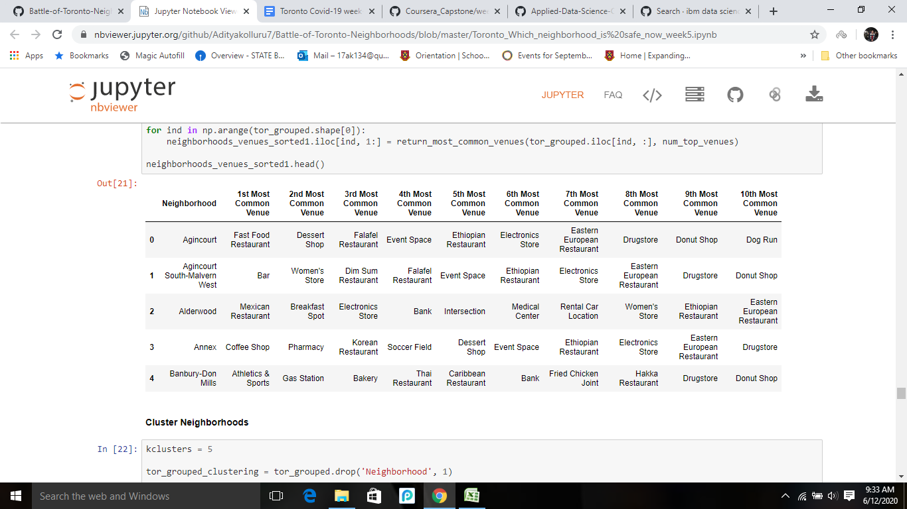
4.The next step is to get the top 30 venues which are close to 500mts of these neighborhoods which will be done using Foursquare API.
5.These top 30 venues are weighed using mean function and the dataframe with the 10 most common venues in each neighborhood is returned.
6.K-cluster analysis is done on this dataframe which clusters each of the neighborhoods into 3 unique clusters.

Slide 9
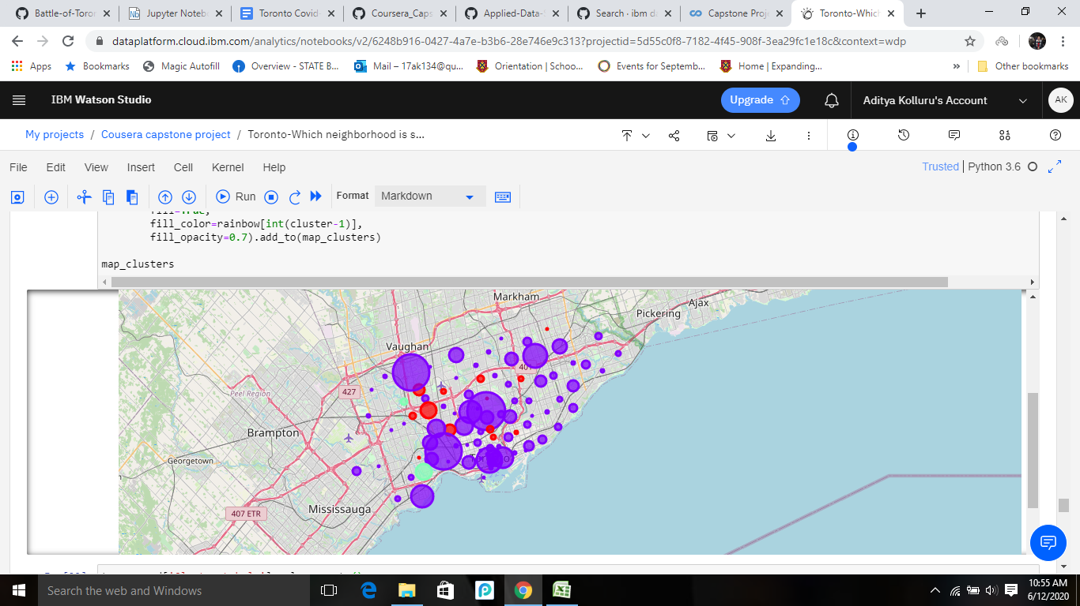
Results:
The results give 5 clusters which are the following:
Cluster 0: Playground dominant neighborhoods with moderate shopping malls (red color)
Cluster 1: Restaurant dominant neighborhoods (purple color)
Cluster 2: Sports field dominant cluster (Mint green)

Slide 10
Discussion and Observations:
From the above map, For a family/person willing to go to
Restaurants, coffee shops, the safest neighborhood would be the East York region, Weston area and more importantly they should avoid going to Downtown Toronto and Etobicoke region.
Parks, shopping malls, the safest neighborhoods are the North York and Scarborough region.
Play sports and convenience stores, the safest neighborhood is Mississauga and Malton region.

Slide 11
Conclusion:
This project identifies the business problem, the data of Covid-19 cases in each neighborhood is extracted, cleaned and venues of each of these neighborhoods are prepared for segregating into 3 clusters by using machine learning techniques. These clusters provide us information about how safe each neighborhood is based on the venue selected.

